Slide 1
[ Meeting Representative Guide ]
MEETING
REPRESENTATIVE

Slide 2
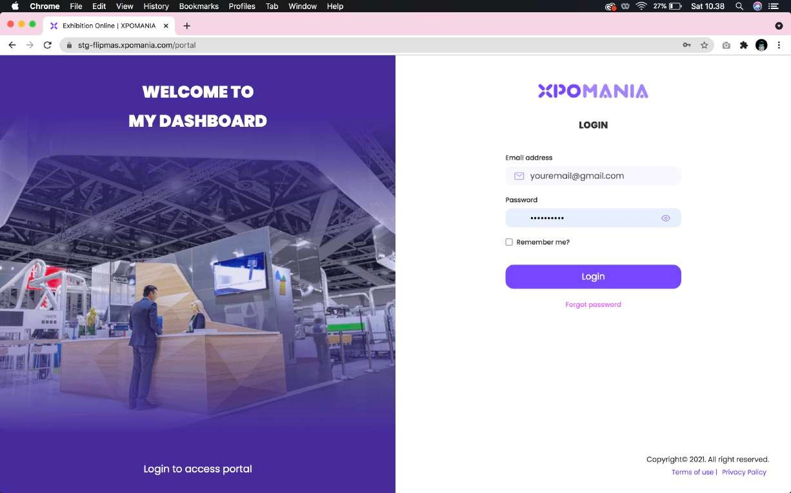
01
Login through the portal: yourevent.xpomania.com/portal using the email and password sent to the registered Meeting Representative account email inbox.
Login Portal menggunakan Akun Meeting Rep

Slide 3
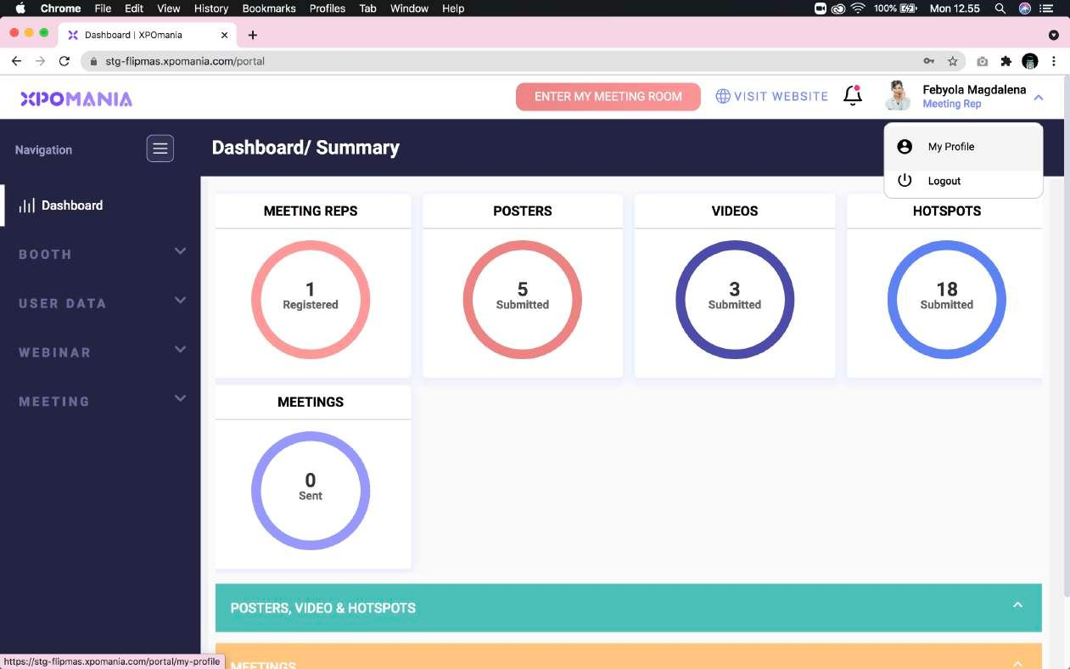
02
To access more settings, click the “My Profile” menu in the upper right corner right next to your name.
My Profile

Slide 4
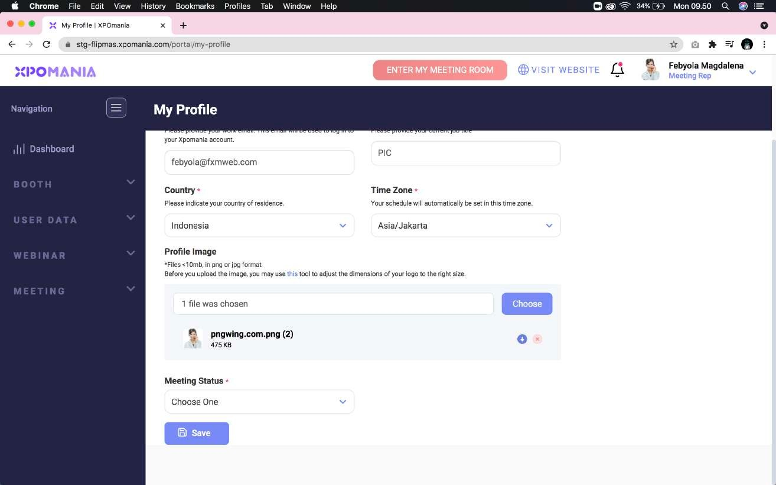
03
You can change your profile photo in the “Profile Image” section.
Profile Image

Slide 5
04
You can set your availability status in the “Meeting Status” section and select a status according to your needs.
Meeting Status

Slide 6
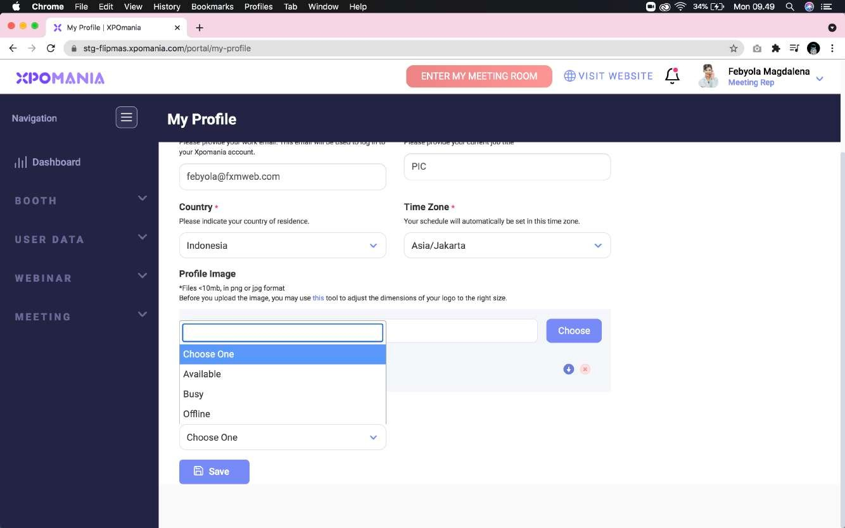
05
Here are the status options that you can choose according to your needs.
Meeting Status Option

Slide 7
06
To start a video meeting, click the “Enter My Meeting Room” button
Enter My Meeting Room

Slide 8
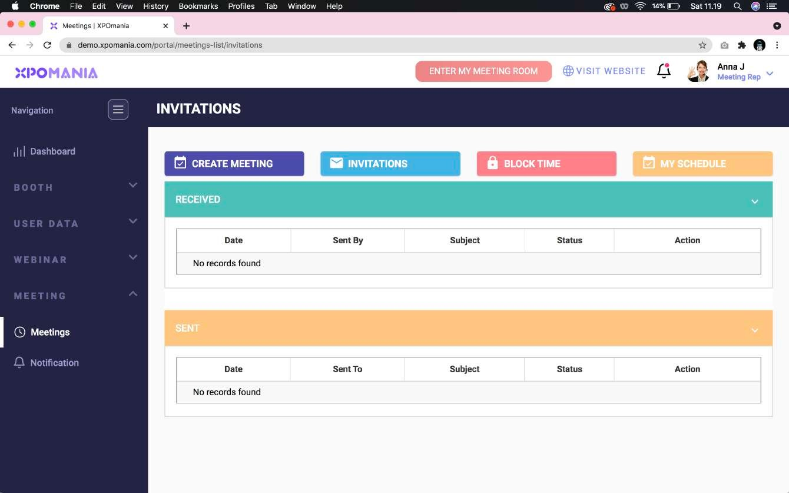
07
You can see the list of meeting invitations from and for you by accessing the “Meeting” > “Meetings” menu on the left menu.
Meetings

Slide 9
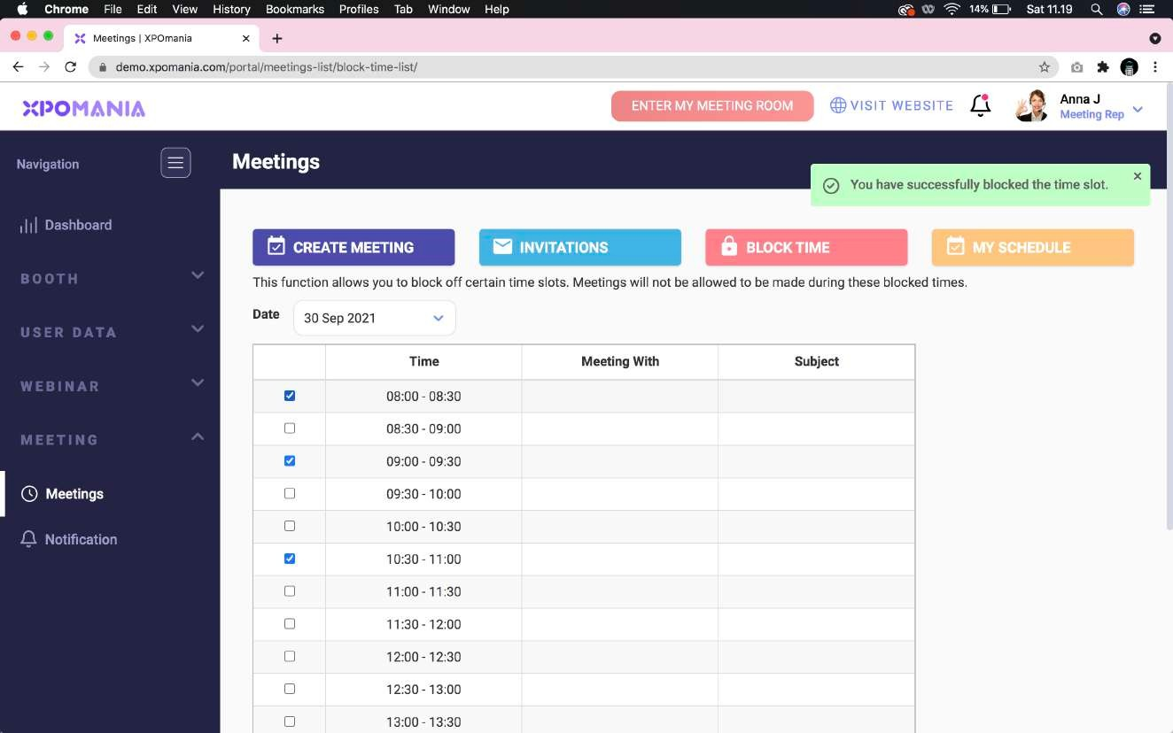
08
You can set “Block Time” in this section. The time slot that you have marked will be recognized by other users who visit your booth as an unavailable time slot.
Block TIme

Slide 10
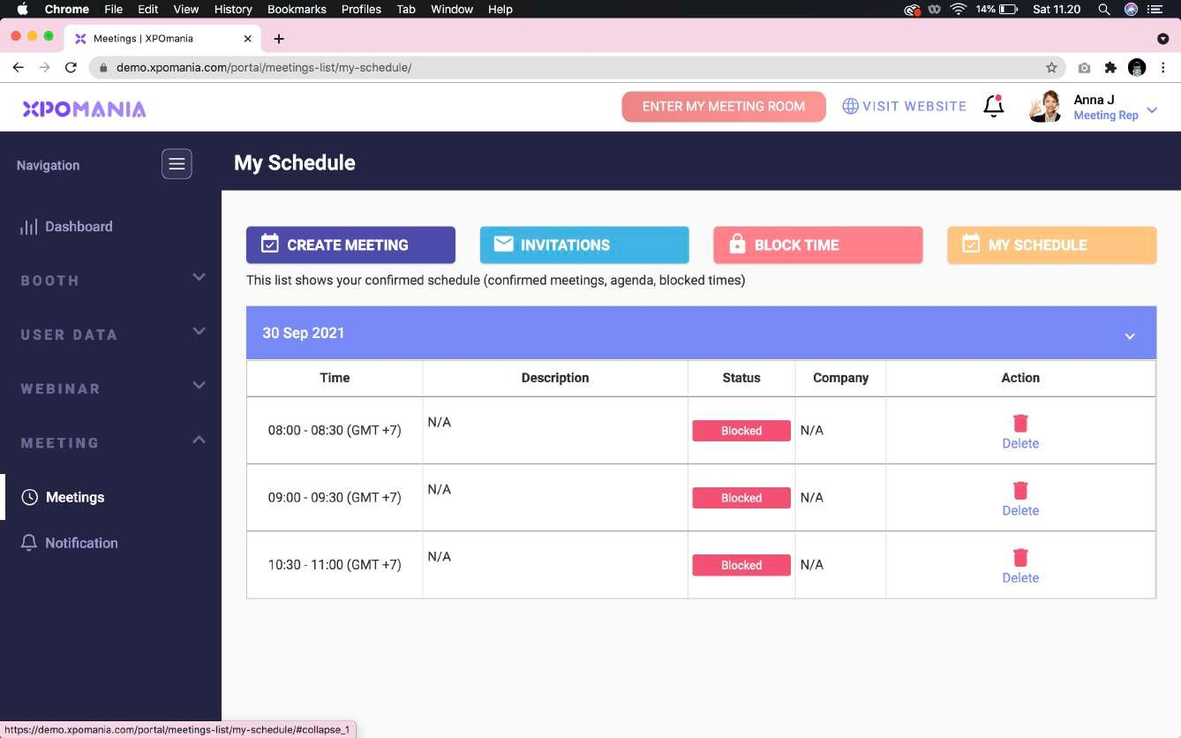
09
You can see your entire confirmed meeting schedule in the “My Schedule” sub menu.
My Schedule

