Slide 1
XPO
XPOMANIA
01
CONTENT
PREPARATION
January 2021

Slide 2
XPO
02
KEY POINTS
Event Logo
Exhibitors Logo
Poster
Video
3D Product
3D Booth Reskin
Video Orbit
Exhibition Maps
Microsite Content & Wireframe
Exhibition Website Theme Concept
TABLE OF
CONTENT

Slide 3
XPO
03
EVENT
LOGO
REQUIREMENTS
VERSION
FORMAT
DIMENSION
FILE SIZE
FILE NAME
Original Logo (Colors version)
.png / .jpg
Min. width 512px
Max. 1MB
Event Name_Logo
Note: It would be even better if you also provide the applicable guideline logo as well.

Slide 4
XPO
EXHIBITOR
LOGO
04
REQUIREMENTS
VERSION
FORMAT
DIMENSION
FILE SIZE
FILENAME
Original Logo (Colors version)
.png / .jpg
Min. width 512px
Max. 1MB
Exhibitor Name_Logo
Note: Our team will also create a 3D version of the logo for the booth, so it would be better if you also provide the applicable guideline logo as well.
3D Logo on the booth

Slide 5
XPO
POSTER
WALL
05
REQUIREMENTS
DIMENSION
ORIENTATION
FORMAT
FILE SIZE
FILENAME
842 x 1191 pixels (A3 Paper size)
Portrait
.jpg / .png
Max. 2 MB
Exhibitor Name_Poster Title
Note: Please give instructions on the specific filename for the main poster that will be attached to the booth as a wall poster. e.g. Exhibitor Name_Poster Wall 01
Poster Wall

Slide 6
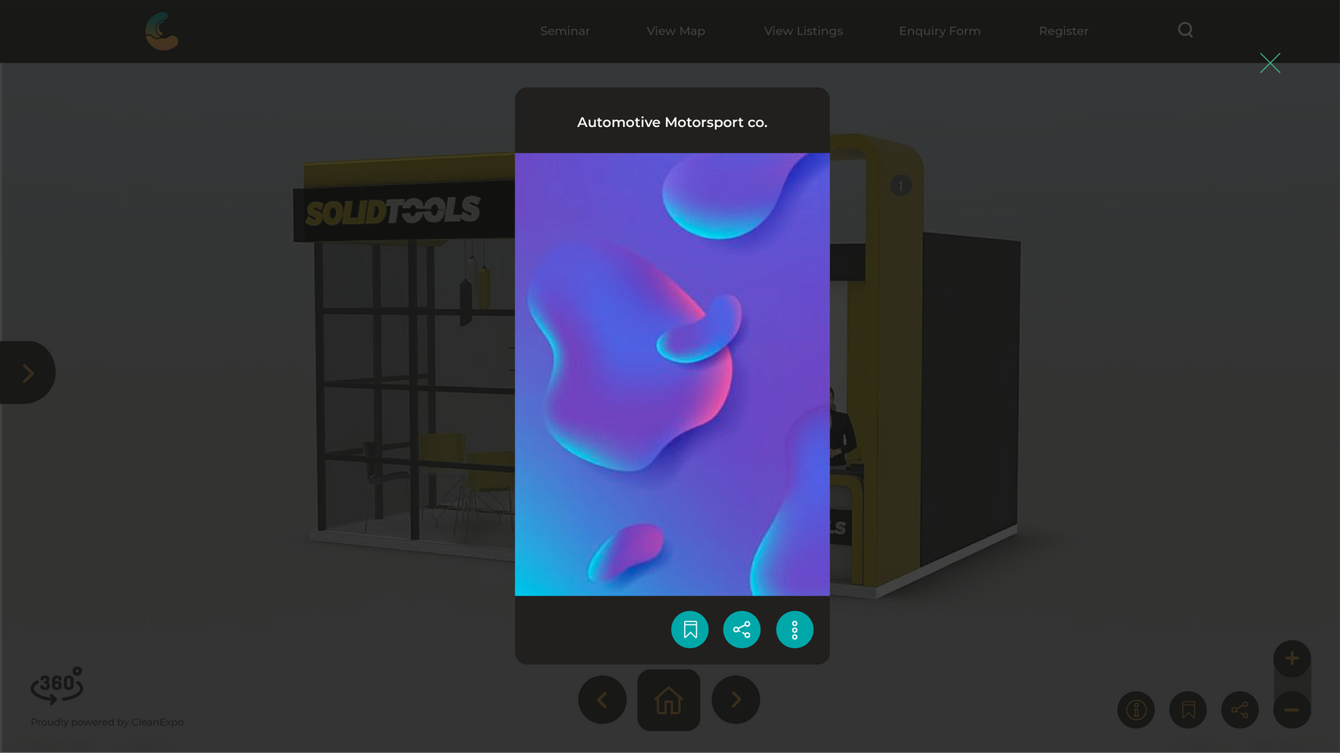
XPO
POSTER
POP-UP
06
REQUIREMENTS
DIMENSION
ORIENTATION
FORMAT
FILE SIZE
FILENAME
842 x 1191 pixels (A3 Paper size)
Portrait
.jpg / .png
Max. 2 MB
Exhibitor Name_Poster Title_Sequence
Note: The maximum recommended number of pop up slides is 5 posters.
Poster Pop up

Slide 7
XPO
07
VIDEO
WALL (CUT)
REQUIREMENTS
DIMENSION
ORIENTATION
FORMAT
FILE SIZE
DURATION
FILENAME
16:9 Screen Ratio
Landscape
.mp4
Max. 5MB
10s -15s
Exhibitor Name_Video Title
Note: If you don't provide a video file for your video wall display, our team will cut the full version of the video randomly (usually 10-15s in the first scene of the video or the best part in our opinion)
Video Wall

Slide 8
XPO
08
VIDEO
FULL VERSION
REQUIREMENTS
DIMENSION
ORIENTATION
FORMAT
FILE SIZE
DURATION
FILENAME
16:9 Screen Ratio
Landscape
.mp4
Unlimited (via YouTube*) ; Max.5MB (via Portal)
Unlimited (via YouTube*)
Exhibitor Name_Video Title
Video Pop up
(Full Version)
Note: Requirements also apply to recorded webinar videos.
*You must upload a high-resolution video to YouTube and provide us with a URL for each video.

Slide 9
3D Product
XPO
10
REQUIREMENTS
Please provide product photos from various angles for the needs of making a 3D version of your product. You can also provide product sizing dimensions for more accurate results.
FILE NAME Exhibitor Name_Product Title_Angle View

Slide 10
LIMITATION
XPO
BOOTH TYPE
POSTER WALL
VIDEO
WALL
POSTER POP-UP
VIDEO
POP-UP
3D PRODUCT
09
Small (S)
Standard Small (SS)
Medium (M)
Standard Medium (SM)
Large (L)
2
2
3
3
5
1
1
2
2
3
5
5
5
5
5
5
5
5
5
5
1
1
1
1
1

Slide 11
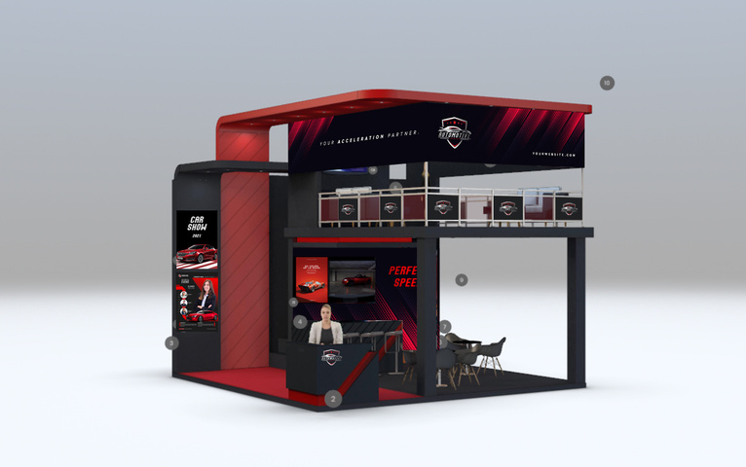
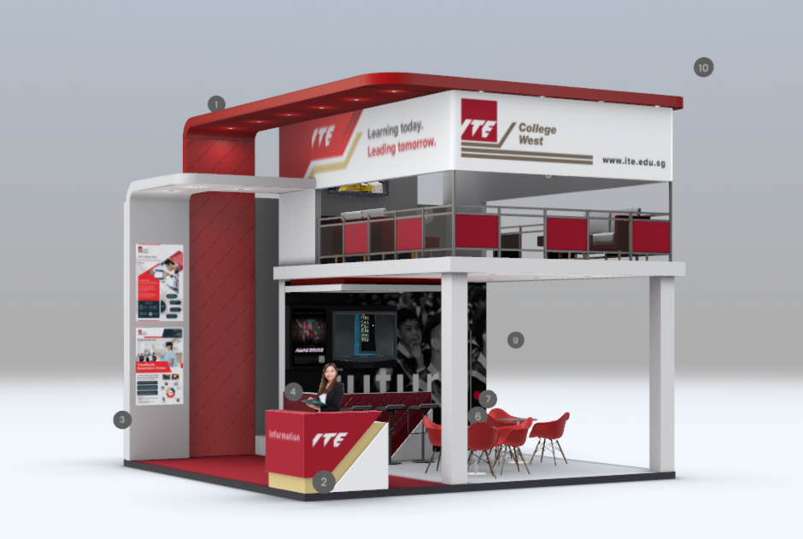
3D Booth Reskin
XPO
11
REQUIREMENTS
You can provide color themes according to the brand concept of each Exhibitor booth. You can choose 3D booth model from our catalogue here: https://www.xpomania.com/booth-library
Please provide information: Exhibitor Name_Booth Model Code
Note: Changes are limited to color, not model structure.
BEFORE
AFTER

Slide 12
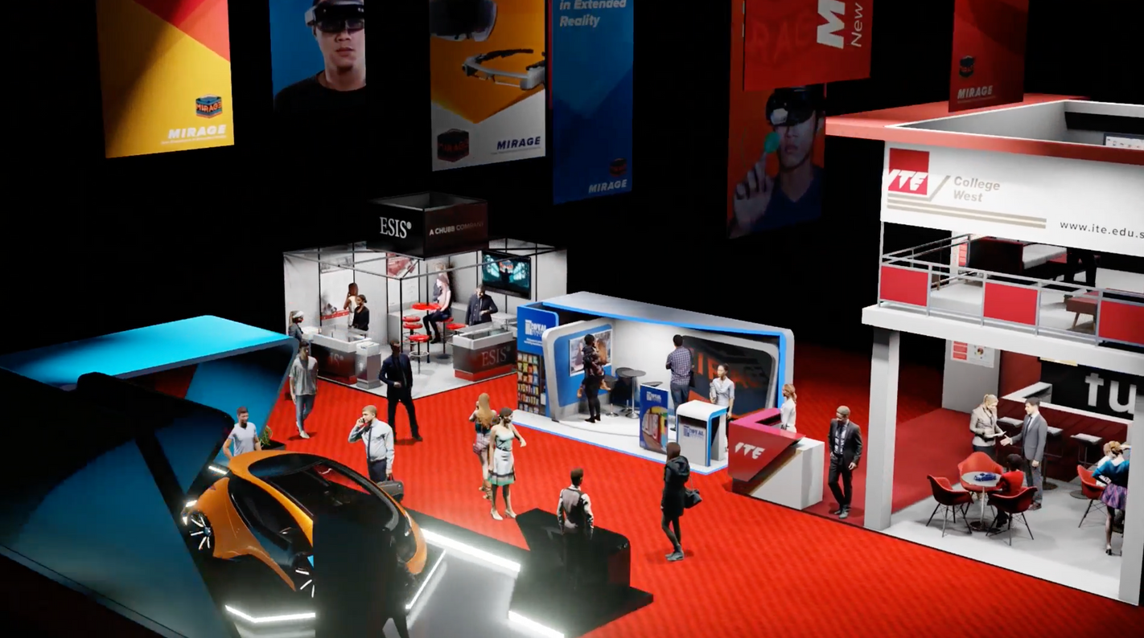
Video Orbit
XPO
12
REQUIREMENTS
Our team will make a video orbit from the entire booth display to be like the original offline exhibition. Please determine a suitable timeline so that our team has sufficient time to make this video orbit before live event.

Slide 13
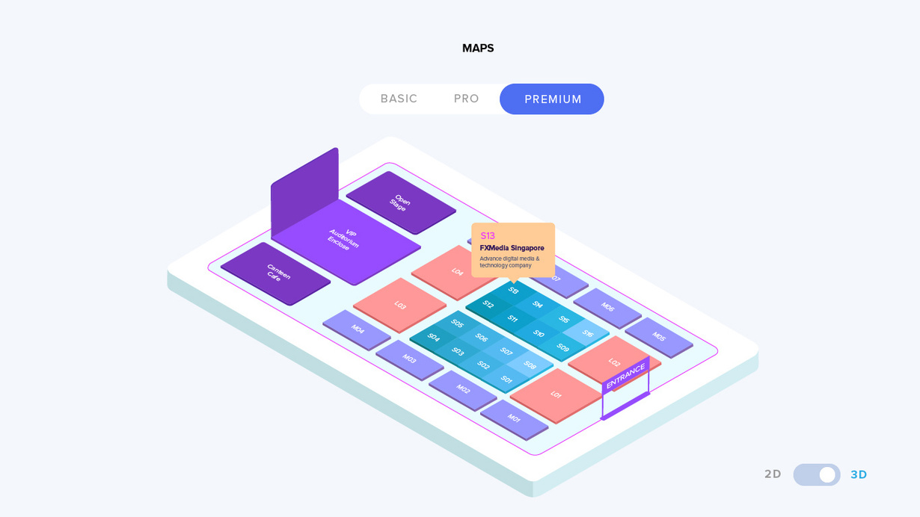
Exhibition Maps
XPO
13
REQUIREMENTS
Please provide an exhibition map layout. We can recreate it in 2D and 3D isometric view.
FILE NAME Event Name_Exhibition Maps

Slide 14
Landing Page
XPO
14
REQUIREMENTS
Please provide suggested content, wireframes if any and event theme guideline such as colors, typography, design style, etc. Along with logos, images, videos, copywriting, social media, etc
Exhibition Website Theme
REQUIREMENTS
Please provide the event theme guideline. We will design a website exhibition theme that matches the concept of the event theme such as color and style of the event as a unified event concept.

Slide 15
XPO
15
XPOMANIA
THANK YOU
www.xpomania.com

